Slide 1


Slide 2

Digital Implementation of Leaky Integrate-and-Fire (LIF) Neurons International Centre for Neuromorphic Systems (ICNS)

Slide 3

Prerequisites:
Basic knowledge of digital circuit design (Practical lecture 1)
Understanding one of the Hardware design languages (Verilog or VHDL) (Practical lecture 1)
Basic knowledge of biological neurons (Introduction to Neuroscience 800230)
PAGE 3

Slide 4
Contents:
Group work: FPGA based design using Verilog
Individual work : Understand a neuron model
Group work: What is LIF neuron model and how to implement it
Optional individual work: Analogue implement of a LIF neuron
PAGE 4

Slide 5
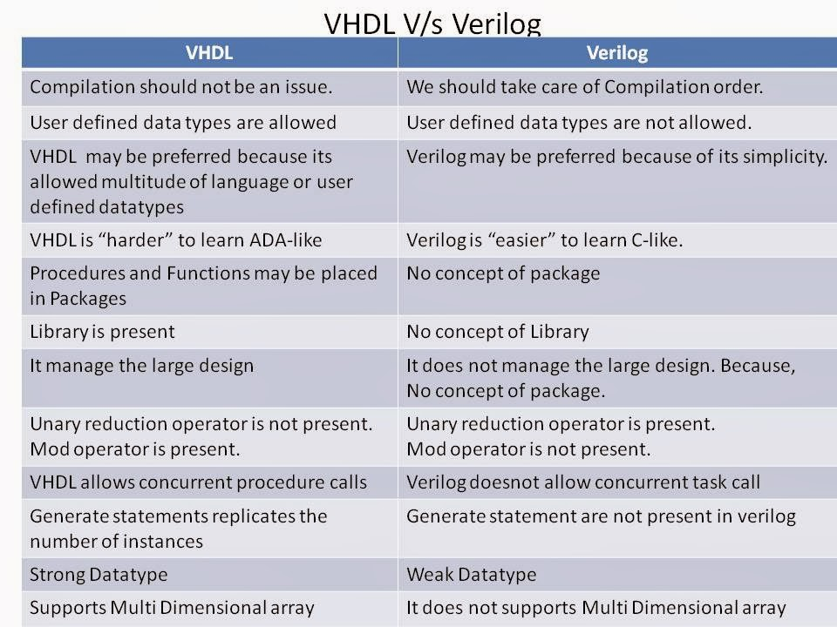
Verilog Hardware Description Language
Discuss 1 : What are the differences of HDLs and programming languages?​
Discuss 2: Verilog VS. VHDL​
Question 1: Assignment Operators (continuous/non-blocking/blocking)?​ Question 2: Block (always/initial) ?​
Question 3: Concurrent and sequential logic?​
Question 4: Events on rising and falling edge of clocks?
Mentioned by Dr. Ali Mehrabi in practical lecture 1
PAGE 5

Slide 6
Verilog Hardware Description Language
Group works : (30 mins)​
Practice 1: Design an 8-bit shift-right register with asynchronised reset​
Practice 2: Make a testbench to test the shift register​
​
Practice 3: Design a Linear Feedback Shift Register (LFSR) depicted in below diagram​
Practice 4: Make a testbench for your LFSR
Mentioned by Dr. Ali Mehrabi in practical lecture 1
PAGE 6

Slide 7
Contents: Question and discussion time

Slide 8
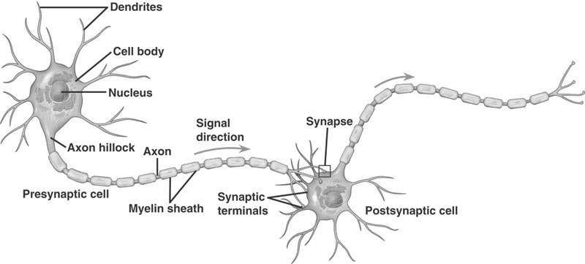
Neuron
Question 3: Key elements of a neuron: fill in blanks
Question 4: Describe the generation of action potential of a neuron
Mentioned by Dr. Yossi Buskila in Introduction to Neuroscience 800230
PAGE 8
Notes:
h5p

Slide 9
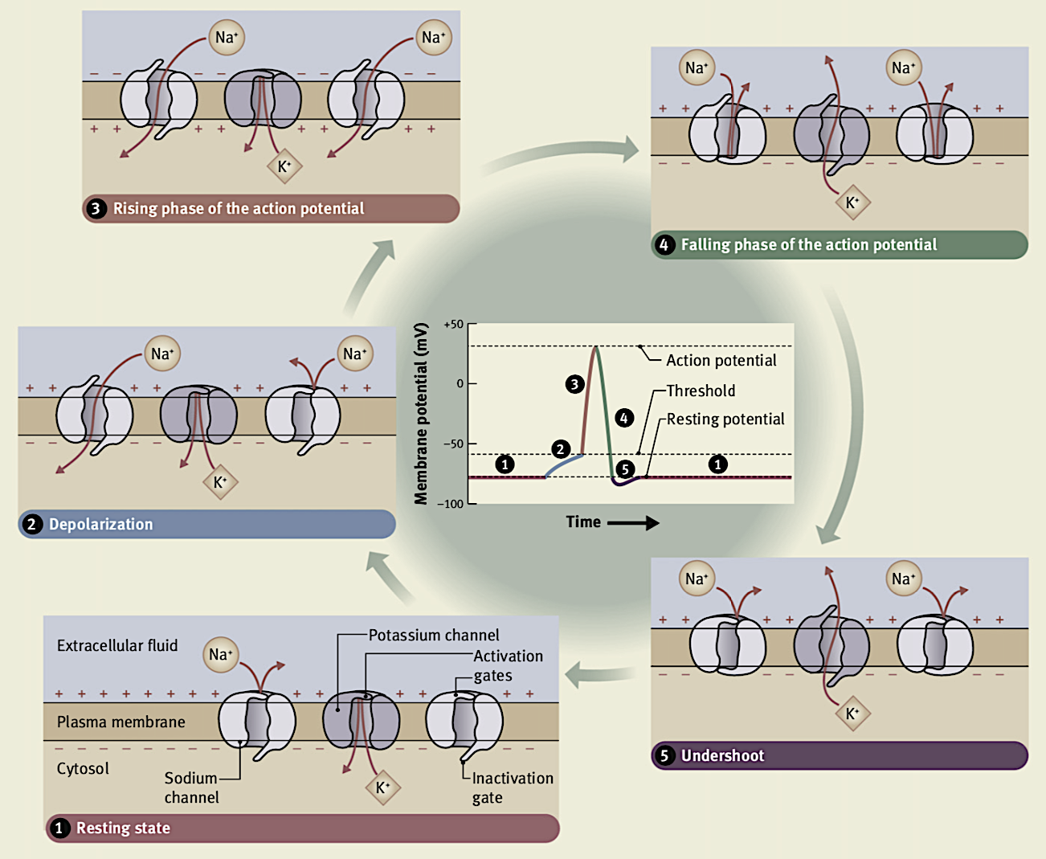
1. The initial resting potential is approximately –75 mV, at which time both the voltage-gated sodium and potassium channels are closed
?
?
2. When a suitable stimulus depolarizes the membrane, some sodium channels open, followed by many other channels
3. when the depolarization attains threshold for triggering the action potential. At this stage, Na+ ions flood down their concentration gradient into the cell and the membrane potential rapidly moves towards the equilibrium potential for Na+ (about +60 mV). However, although the membrane potential does become positive, it does not attain the Na+ equilibrium potential because the sodium channels quickly close.
4. Approximately 1 ms after opening, the voltage-gated sodium channels close because of the ‘inactivation’ gate ‘slamming’ shut. At this time, the voltage-gated potassium channels open, allowing K+ ions to ‘flood’ out of the cell to rapidly repolarize the membrane. With the inactivation gates shut, the sodium channels are inactivated and unresponsive to any depolarizing stimulus; this represents the absolute refractory period when the membrane cannot respond to any stimulus. When the membrane potential again reaches the normal resting value (owing to the sustained opening of the voltage-activated potassium channels), the inactivation gates of the sodium channels ‘swing’ open (deinactivation of the channels) and the membrane is again responsive to depolarizing stimuli.
?
?
?
5. The voltage-gated potassium channels actually remain open long enough for the membrane potential to ‘undershoot’ the resting value transiently (i.e. the membrane is temporarily hyperpolarized). At this time (the relative refractory period), the sodium channels are again responsive (deinactivated) but a larger depolarizing stimulus is required to trigger an action potential
Mentioned by Dr. Yossi Buskila in
Introduction to Neuroscience 800230
PAGE 9
Notes:
h5p

Slide 10
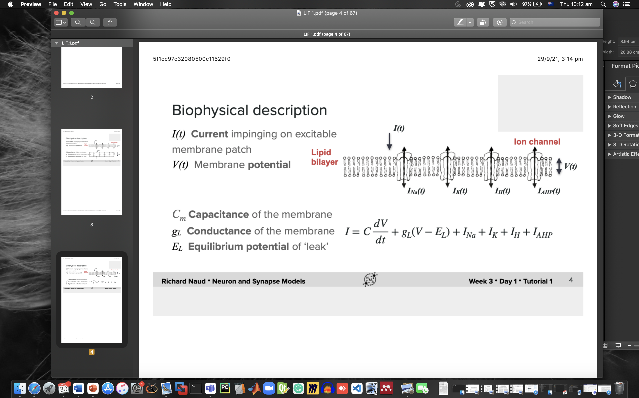
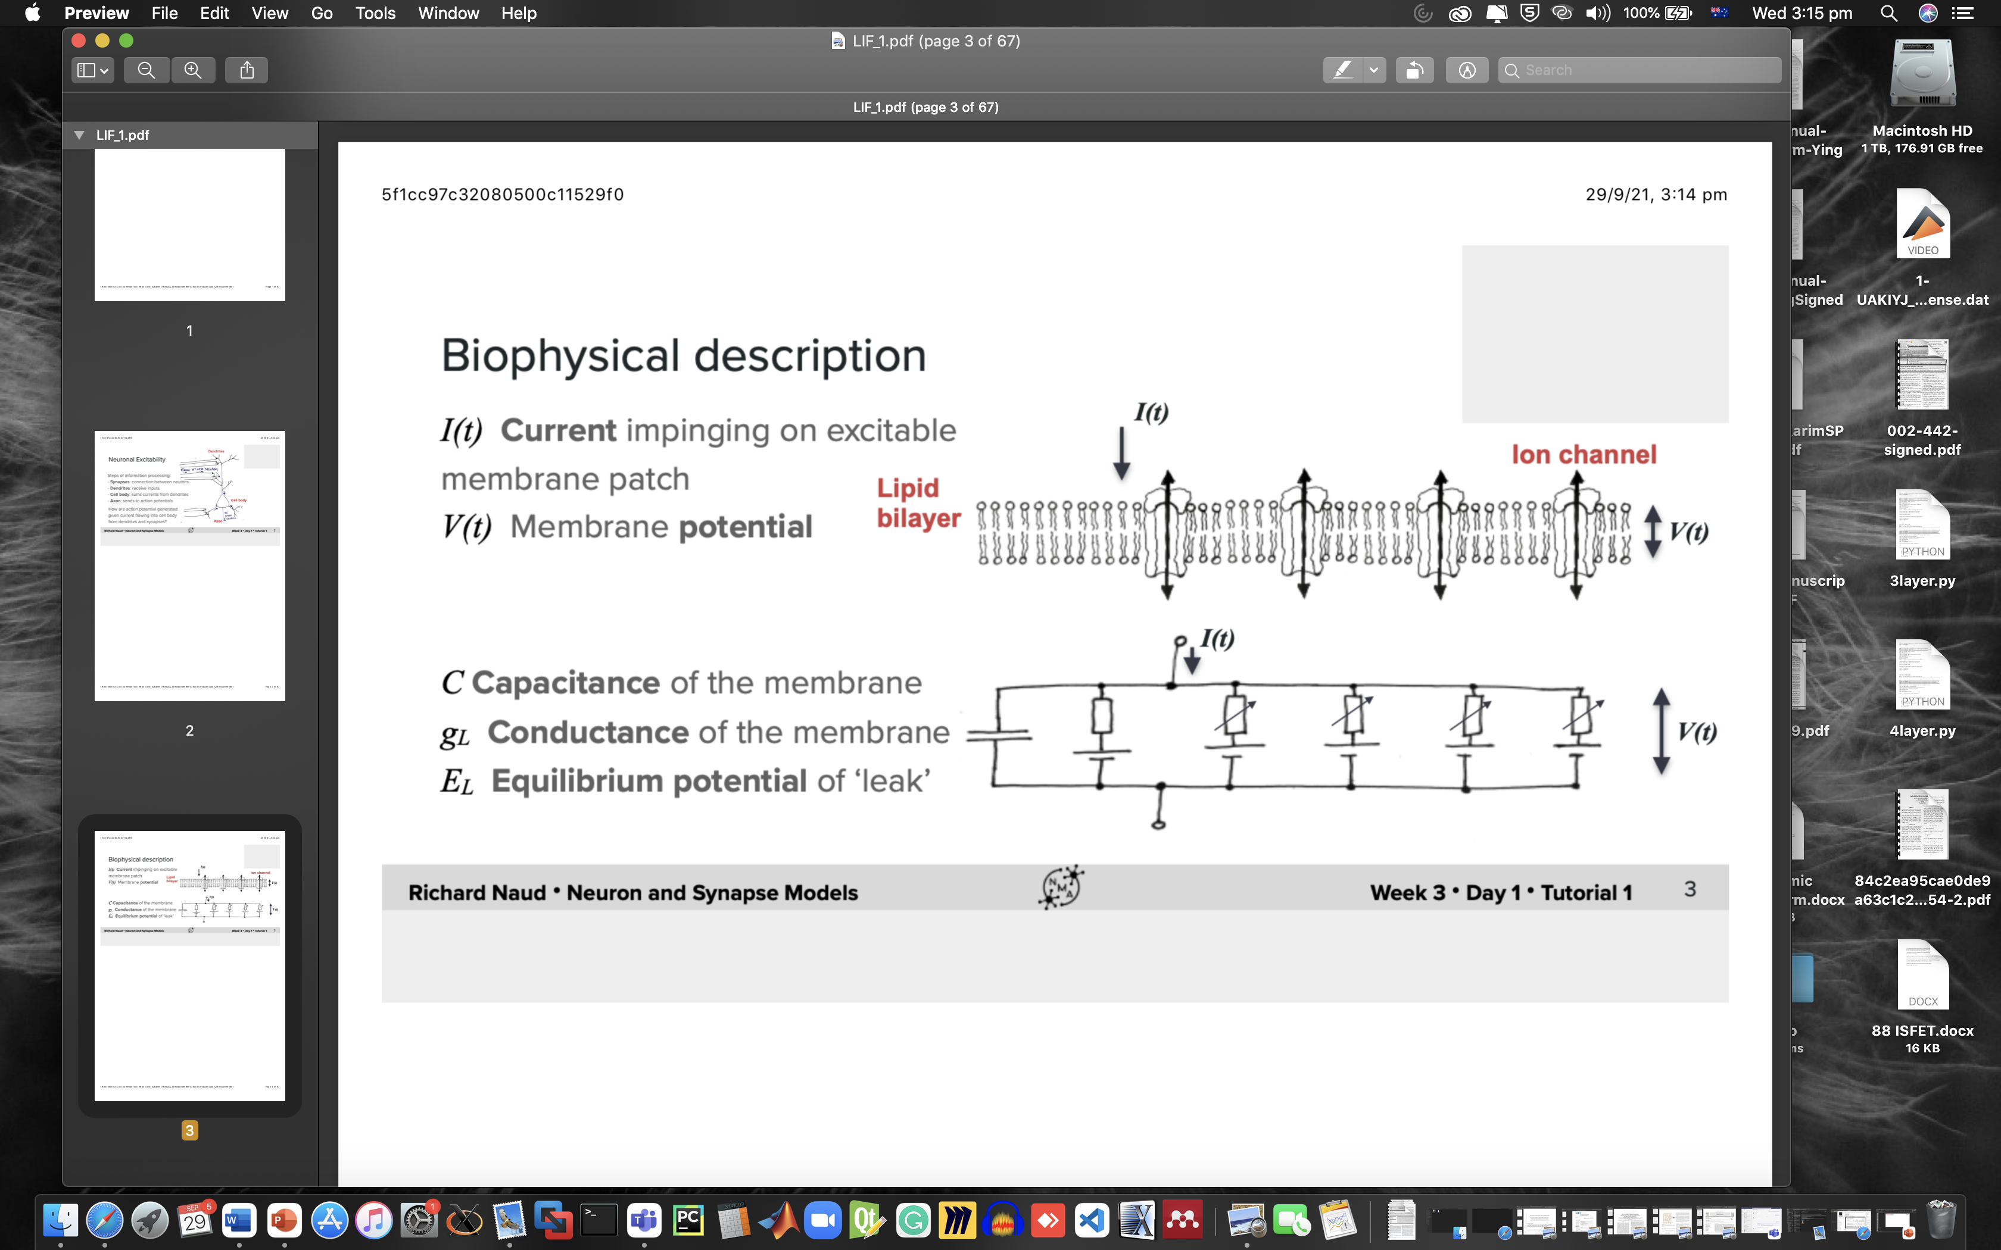
Neuron to RC Circuitry
Approximation: All the ion channels are clumped at the same time
Hodgkin–Huxley model (1952)
PAGE 10

Slide 11
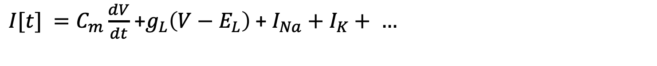
Neuron to RC Circuitry
...
$I[t] =C_{m}\frac{dV}{dt}$ +$g_{L}\left(V−E_{L}\right)$ + $I_{Na}+I_{K}+ …$
$=C_{m}\frac{dV}{dt}$ +$g_{L}\left(V−E_{L}\right)+g_{N_{a}}m^{3}h\left(V−E_{N_{a}}\right)+g_{K}n^{4}\left(V−E_{K}\right)$ $+ . . .$
PAGE 11

Slide 12
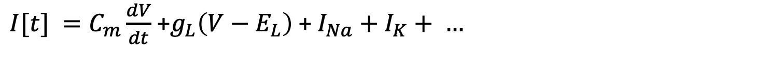

Neuron to RC Circuitry
$I[t] =C_{m}\frac{dV}{dt}$ +$g_{L}\left(V−E_{L}\right)$ + $I_{Na}+I_{K}+ …$
$=C_{m}\frac{dV}{dt}$ +$g_{L}\left(V−E_{L}\right)+g_{N_{a}}m^{3}h\left(V−E_{N_{a}}\right)+g_{K}n^{4}\left(V−E_{K}\right)$ $+ . . .$
($m,h,n, functions of V,$ activation variables to model the probability that each channel is open at a given moment of time)
Non-linear differential equations don’t have any analytical answer,
Cost a lot of transistors
Approximation
PAGE 12

Slide 13
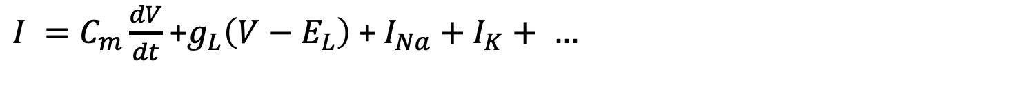
Neuron to RC Circuitry
$I =C_{m}\frac{dV}{dt}$ +$g_{L}\left(V−E_{L}\right)$ + $I_{Na}+I_{K}+ …$
Approximation. 1: simple soma model with leak
Ignore for now
$I=C_{m}\frac{dV}{dt}$ +$g_{L}\left(V−E_{L}\right)$
PAGE 13

Slide 14
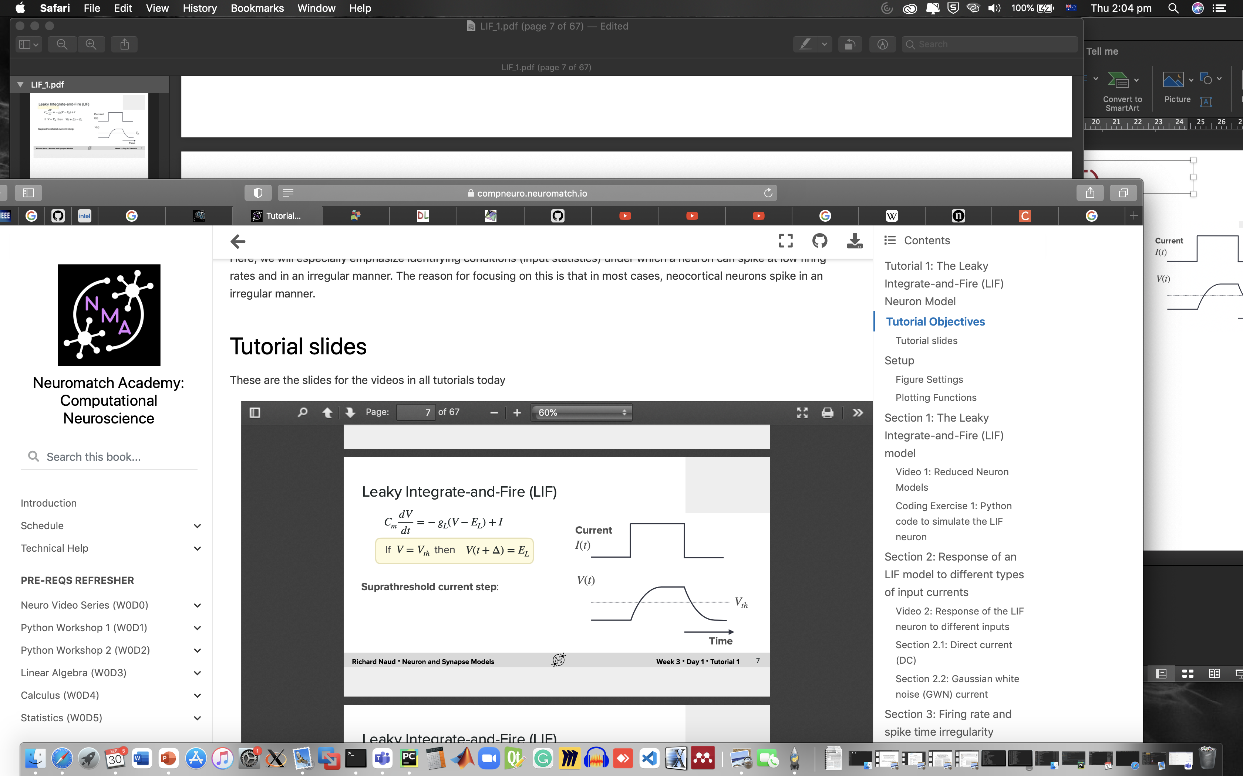

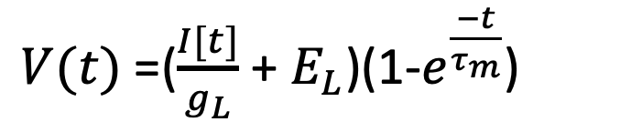

Leaky Integrate-and-Fire (LIF)
$I[t] =C_{m}\frac{dV}{dt}$ +$g_{L}(V−E_{L})$
solution of the differential equation:
Compare
$V(t)$ =($\frac{I[t]}{g_{L}}$ + $E_{L}$)(1-$e^{\frac{−t}{τ_{m}}}$)
Integrate
Reset
PAGE 14

Slide 15
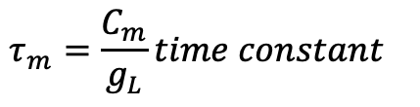
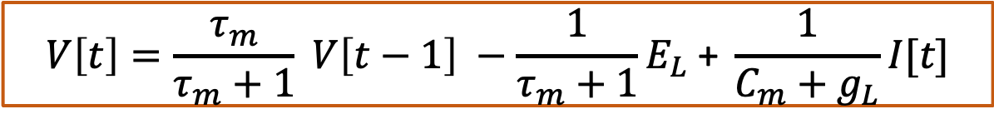
Digital Implementation
$C_{m}\frac{dV}{dt}$ $=$ $I[t]$ $− g_{L}(V−E_{L})$
$C_{m}(V[t]$ $−$ $V[t−1])$ = $I[t$] $− g_{L}\left(V[t]−E_{L}\right)$
$$V\left[t\right]=\frac{τ_{m}}{τ_{m}+1} V\left[t−1\right] −\frac{1}{τ_{m}+1}E_{L} \text{+ }\frac{1}{C_{m}+g_{L}}I[t\text{]}$$
$$τ_{m}=\frac{C_{m}}{g_{L}}time constant$$
PAGE 15

Slide 16
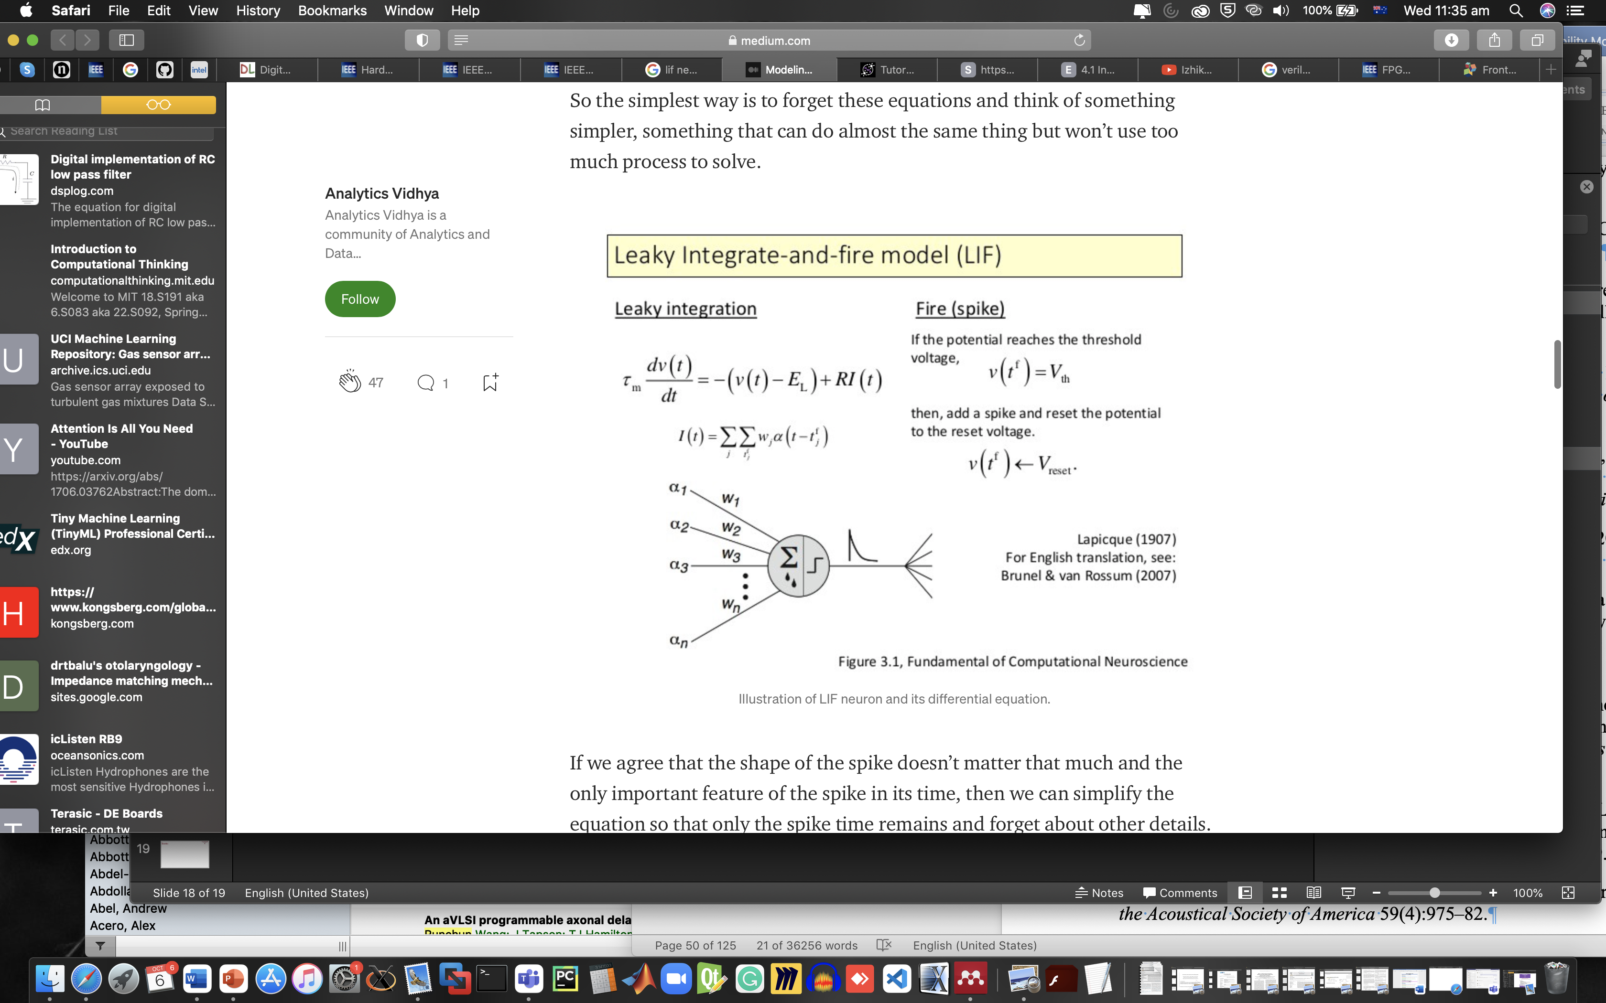
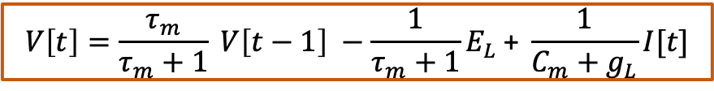
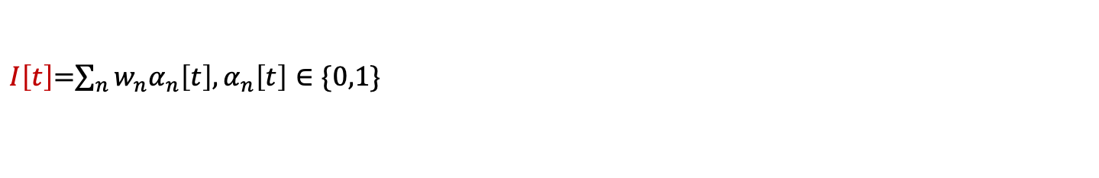
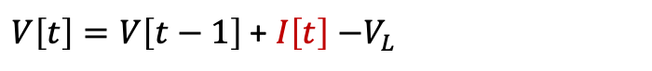
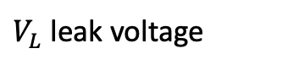
Leaky Integrate-and-Fire (LIF)
$$V\left[t\right]=\frac{τ_{m}}{τ_{m}+1} V\left[t−1\right] −\frac{1}{τ_{m}+1}E_{L} \text{+ }\frac{1}{C_{m}+g_{L}}I[t\text{]}$$
Approximation. 2:
Synapse
$V_{L}$ leak voltage
$V\left[t\right]=V\left[t−1\right] \text{+ }I\left[t\right]$ $−V_{L}$
$I\left[t\right]$=$\sum_{n}{w_{n}α_{n}\left[t\right],α_{n}\left[t\right]}∈\{0,1\}$
$w_{n}$ synaptic weights, $α_{n}$ arrival of presynaptic spike
A. Cassidy, S. Denham, P. Kanold and A. Andreou, "FPGA Based Silicon Spiking Neural Array," 2007 IEEE Biomedical Circuits and Systems Conference, 2007, pp. 75-78, doi: 10.1109/BIOCAS.2007.4463312.
PAGE 16

Slide 17
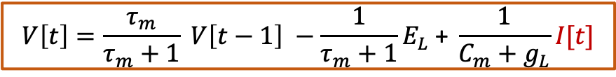

Leaky Integrate-and-Fire (LIF)
$$V\left[t\right]=\frac{τ_{m}}{τ_{m}+1} V\left[t−1\right] −\frac{1}{τ_{m}+1}E_{L} \text{+ }\frac{1}{C_{m}+g_{L}}I[t\text{]}$$
Approximation. 3:
Synapse with a time constant
$$I\left[t\right]=\frac{τ_{p}}{τ_{p}+1} I\left[t−1\right] −gU[t]$$
$g$ conductance, $U[t]$total input voltage
Wang, Runchun M., Chetan S. Thakur, and André van Schaik. 2018. “An FPGA-Based Massively Parallel Neuromorphic Cortex Simulator.” Frontiers in Neuroscience.
PAGE 17

Slide 18
Digital Implementation of LIF Neuron
Group works : (90 mins)
Practice 3 : Discuss and build a LIF neuron model using Verilog
PAGE 18

Slide 19
Contents: Question and discussion time

Slide 20
Digital Implementation of LIF Neuron
Stochastics in a digital neuron
Question 4 : Discuss ways of emulating stochastics of biological neurons a digital design and add it in Practice 4
PAGE 20

Slide 21
Contents: Question and discussion time

Slide 22
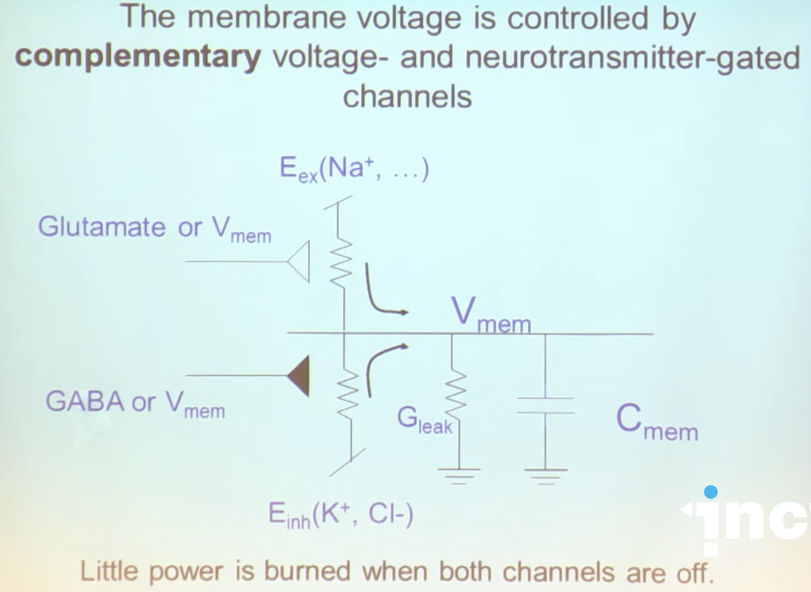
Analogue Implementation of a LIF neuron
Analogue circuit design
PAGE 22

Slide 23
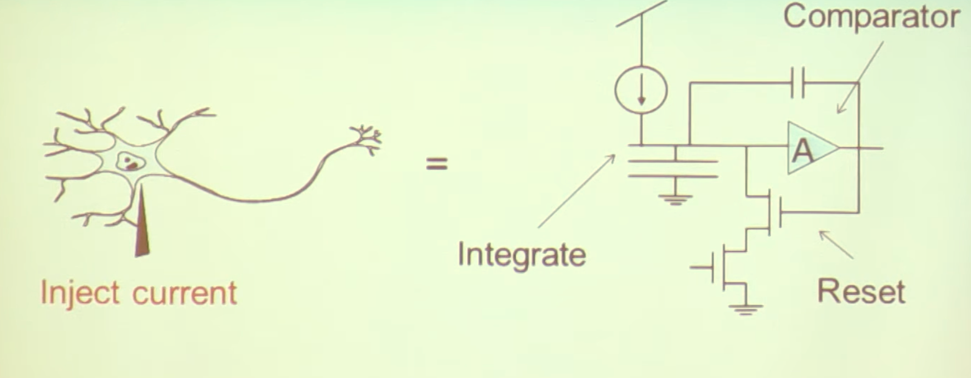
Analogue Implementation
Approximation
PAGE 23

Slide 24
Analogue Implementation of a LIF neuron
Analogue layout
PAGE 24

Slide 25
Books and publications : Verilog and FPGA: https://west-sydney-primo.hosted.exlibrisgroup.com/permalink/f/afm582/UWS-ALMA2170487320001571 Analog VLSI: Circuits and Principles: https://ezproxy.uws.edu.au/login?url=https://ieeexplore.ieee.org/book/6267299 Neuromorphic silicon neuron circuits: https://ezproxy.uws.edu.au/login?url=https://www.frontiersin.org/articles/10.3389/fnins.2011.00073/full Neuromorphic engineering systems and applications: https://west-sydney-primo.hosted.exlibrisgroup.com/permalink/f/afm582/UWS-ALMA51173262710001571
PAGE 25

Slide 26
Summary:
From neuron to digital LIF neuron circuit
Design a LIF neuron circuit using Verilog
Comparison between an analogue and digital implmentation of a LIF neuron
PAGE 26

